Slide 1
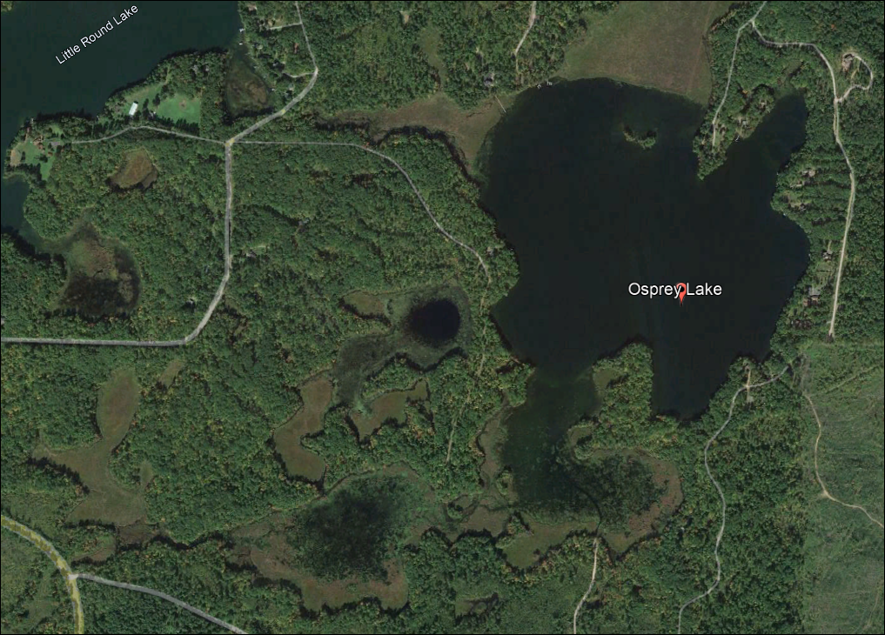
Osprey Lake 2023 Annual Meeting

Slide 2
2023-24 Grant Award
EWM management planning
Chemical treatment (ProcellaCOR)
Herbicide concentration testing
Diver/DASH removal
Fall EWM surveys
Purple loosestrife beetle rearing
Water quality testing
AIS monitoring (by constituency)
AIS education event
*Pre and post-treatment aquatic plant survey
Total Value = $37,895.25
State Award = $28,421.44
OLPOA Share = $9,473.81

Slide 3
What is the money for?
2023 chemical treatment of EWM
  $20,179.00
2024 follow up diver/DASH removal
  $4,544.00
EWM management planning and survey work
  $5813.00
Water quality testing, AIS education, administration, sharing of information, meeting attendance
  $7,359.00
Well, That was the plan anyway!

Slide 4
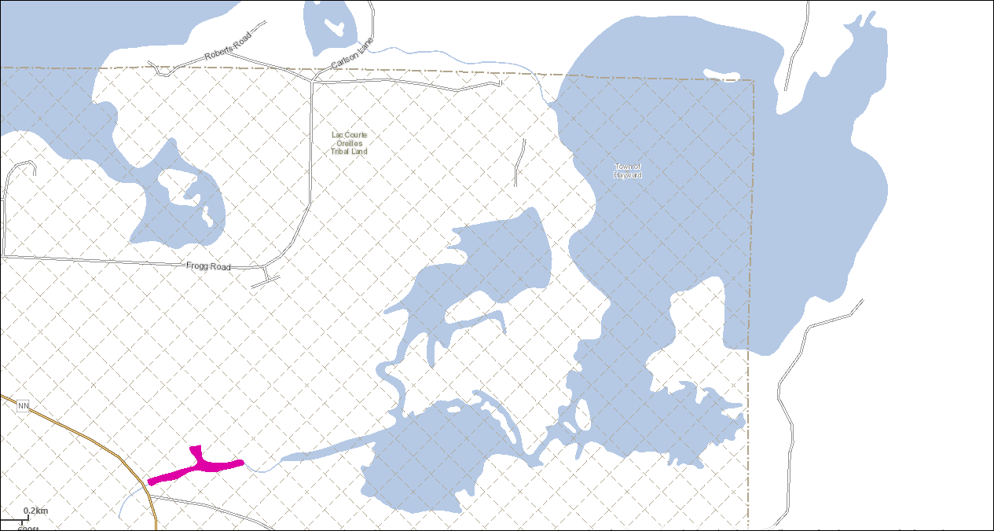
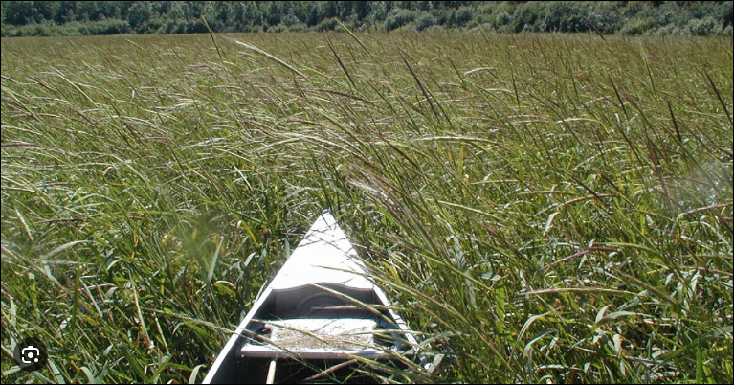
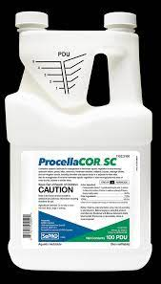
Application of Herbicides
Better than 2,4D or triclopyr
  Applied in ounces not gallons
  Kills EWM in 2-4 hours
  More selective in terms of what it kills
  No swimming, fishing, or irrigation restrictions after use
  Results last 3 to 4 years
  May move around and take out EWM in areas not in the treatment area
ProcellaCOR

Slide 5
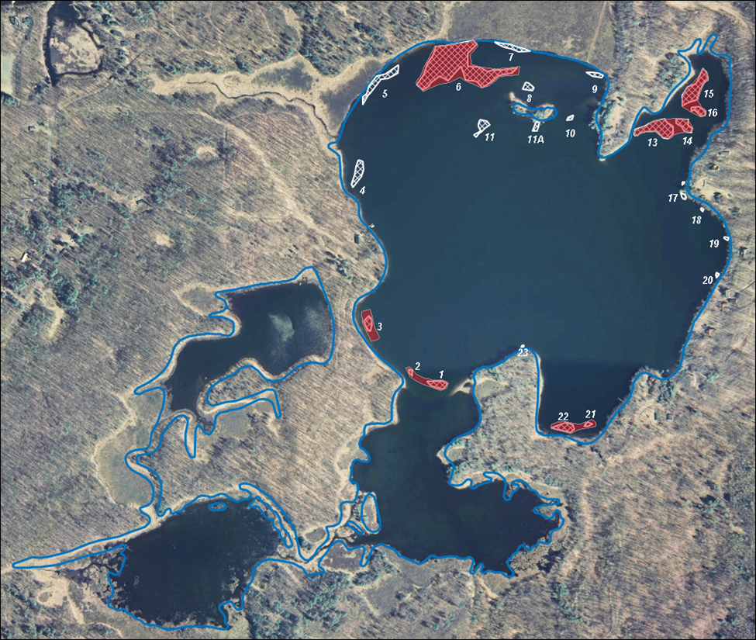
Here’s what really is happening!
DASH

Slide 6
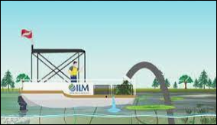
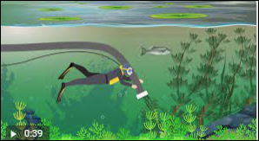
What is DASH?
Diver Assisted Suction Harvest
Mechanical control
  Contracted
  $2,600.00/day
3 people and a boat w/special equipment
Need a place to unload and dump the harvested materials

Slide 7
EWM Management
2023
  Two days of DASH
  Physical removal by property owners
2024
  Application of ProcellaCOR (maybe)
  Application of a different herbicide (?)
  More DASH (?)
  Physical removal by property owners

Slide 8
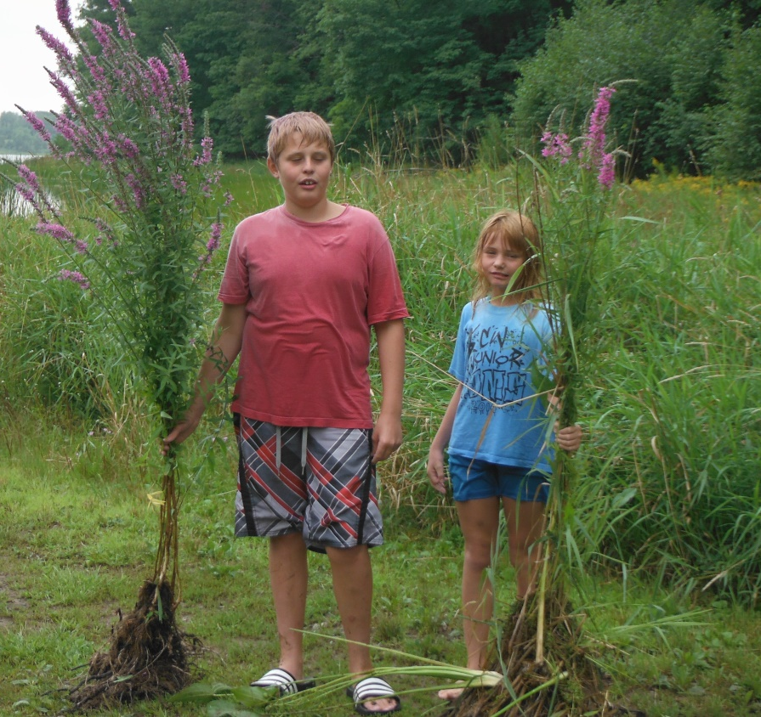
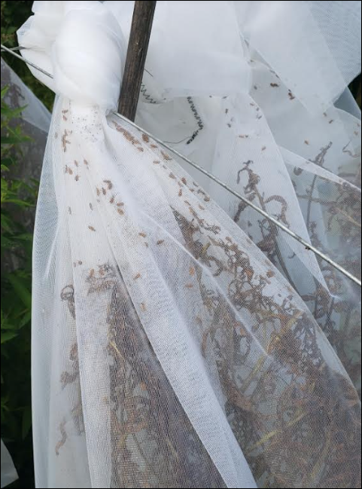
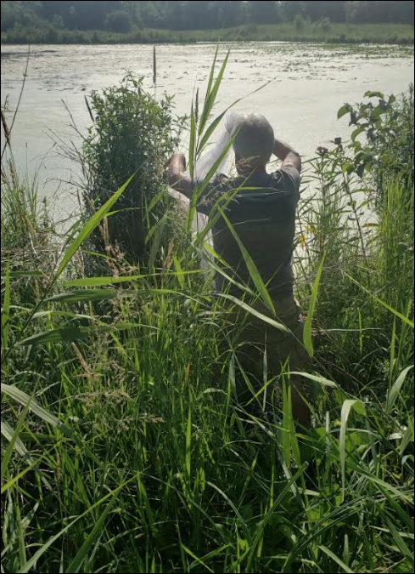
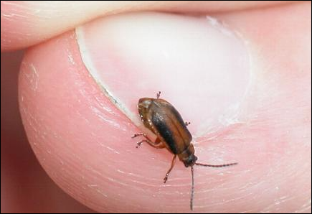
Purple Loosestrife Beetles
Shoreland and wetland invasive species
Can be controlled effectively with beetles
The beetles only eat purple loosestrife

Slide 9
QUESTIONS?

